Slide 1

Network Layer:IPv4 Addressing
Computer Communication and Networks
Session 11
Tutor: Karma Wangchuk

Slide 2

Network Layer
Learning Outcome:- At the end of the lesson, you are expected to be able to:
  Identify type of addressing.
  Define IPv4 Addressing.
  Demonstrate IPv4 networking.
  Subnetting
  Supernetting

Slide 3
TCP/IP Protocol Suite
Addressing:
  Four level of addresses are used in an internet.
    Physical(link) addresses
    Logical(IP) addresses
    Port addresses
    Specific addresses
Relationship of layers and addresses in TCP/IP

Slide 4
TCP/IP Protocol Suite: Physical Address
Physical Address: It is also called as Link Address or Hardware Addressing
  A hardware address is used to uniquely identify a host within a local network.
  Ethernet utilizes the 48-bit MAC address as its hardware address.
  Ethernet uses 6-byte (48-bits) physical address imprinted on NIC card.
  A MAC address is most often represented in hexadecimal, using one of two accepted formats:
          00:43:AB:F2:32:13
          0043.ABF2.3213

Slide 5
TCP/IP Protocol Suite: Physical Address
Physical Address: MAC Address
  The first six hexadecimal digits of a MAC address identify the manufacturer of the physical network interface.
    This is referred to as the OUI (Organizational Unique Identifier).
  The last six digits uniquely identify the host itself, and are referred to as the host ID.

Slide 6
TCP/IP Protocol Suite: Logical Address
Logical Address: It is also called as IP Address
  Logical addresses are necessary for universal communications that are independent on underlying physical network.
  The physical address will change from hop-to-hop, but logical address remain same.
  Two types of IP addressing:
    IPv4 (Example 172.23.21.99)
    IPv6 ( Example 3ffe:1900:4545:3:200:f8ff:fe21:67cf)

Slide 7
TCP/IP Protocol Suite: Port Address
Port Address:
  It is a label assigned to a process.
    Computer A communicate with Computer B through TELNET, at the same time computer A communicate with Computer C by using FTP. For these processes to receive data simultaneously, different label are assigned to different processes. This label assigned to a process is called Port Address.
  The port address in TCP/IP is 16-bit represented as one single number.
  The physical address changes from hop to hop but IP & Port address remain the same

Slide 8
TCP/IP Protocol Suite: Specific Address
Specific Address:
  There are some application system which designed the user-friendly address called specific address.
  Address like email address, URL(Uniform Resource Locator), are example of specific address.
    karmastar17@gmail.com
    karma.cst@rub.edu.bt
    www.cst.edu.bt
    https://karmacst.github.io/gawa

Slide 9
TCP/IP Protocol Suite: IPv4 Addressing
IPv4 Addresses:
  A core function of IP is to provide logical addressing for hosts.
  An IP address provides a hierarchical structure to both uniquely identify a host, and what network that host exists on.
  IPv4 is 32 bits length, unique & universally defines the connections of devices to the Internet.
      Divided into four octets
  The address space of IPv4 is 2³² or 4,294,967,296 (more than 4 billion).

Slide 10
TCP/IP Protocol Suite: IPv4 Addressing
IPv4 Addresses:
  Two notations to show IPv4:
      Dotted-decimal notations (140.128.2.7).
      Binary notation (10001100 10000000 00000010 00000111).
  An IP address is most often represented in decimal:
  158.80.164.3
  An IP address is comprised of four octets, separated by periods:
  First Octet Second Octet Third Octet Fourth Octet
  158 80 164 3

Slide 11
TCP/IP Protocol Suite: IPv4 Addressing
IPv4 Addresses:
  The above IP address represented in binary would look as follows:
  First Octet Second Octet Third Octet Fourth Octet
  10011110 01010000 10100100 00000011
  Each octet is an 8-bit number, resulting in a 32-bit IP address.
  The smallest possible value of an octet is 0, or 00000000 in binary.
  The largest possible value of an octet is 255, or 11111111 in binary.

Slide 12
TCP/IP Protocol Suite: IPv4 Addressing
IPv4 Addresses: Classful Addressing
  IPv4 addresses used the concept of classes.
  In classful addressing, the address space is divided into five classes: A, B, C, D, E.
  Address classes in binary and dotted-decimal can be found as:

Slide 13
TCP/IP Protocol Suite: IPv4 Addressing
IPv4 Addresses: Netid and Hostid
  The Class A, B, C is divided into netid and hostid.
    Class A: 1st octet define netid and rest 3 octet define hostid.
    Class B: 1st and 2nd octets define netid and 3rd and 4th hostid.
    Class C: 1st three octets define netid and last octet hostid.
  Class A, B & C address is for Unicast application
  Class D for Multicast application and Class E is reserved for future use.
  Class D & E don’t follow the division of netid and hostid.

Slide 14
TCP/IP Protocol Suite: IPv4 Addressing
IPv4 Address Format:

Slide 15
TCP/IP Protocol Suite: IPv4 Addressing
Subnet Mask: It is also called Default Mask
  The mask helps to find Netid and Hostid.
  A mask is a 32-bit number in which the n leftmost bits are 1s and the 32-n rightmost bits are 0s.
      A 32-bit number made of contiguous 1s followed by contiguous 0s.
  The concept of mask does not apply for class D & E.
  Class A, B & C default masks are shown below:

Slide 16
TCP/IP Protocol Suite: IPv4 Addressing
Subnet Mask: Identification of NetID and HostID
  Part of an IP address identifies the network. The other part of the address identifies the host.
    A subnet mask is required to provide this distinction:
  158.80.164.3 255.255.0.0
  The above IP address has a subnet mask of 255.255.0.0.
    The subnet mask follows two rules:
      If a binary bit is set to a 1 (or on) in a subnet mask, the corresponding bit in the address identifies the network.
      If a binary bit is set to a 0 (or off) in a subnet mask, the corresponding bit in the address identifies the host.

Slide 17
TCP/IP Protocol Suite: IPv4 Addressing
Subnet Mask: Identification of NetID and HostID
  Looking at the above address and subnet mask in binary:
    IP Address: 10011110.01010000.10100100.00000011
    Subnet Mask: 11111111.11111111.00000000.00000000
  The first 16 bits of the subnet mask are set to 1.
    Thus, the first 16 bits of the address (158.80) identify the network.
  The last 16 bits of the subnet mask are set to 0.
    Thus, the last 16 bits of the address (164.3) identify the unique host on that network.

Slide 18
TCP/IP Protocol Suite: IPv4 Addressing
Subnet Mask:
  The network portion of the subnet mask must be contiguous.
    For example, a subnet mask of 255.0.0.255 is not valid.
  Hosts on the same logical network will have identical network addresses, and can communicate freely.
    For example, the following two hosts are on the same network:
      Host A: 158.80.164.100 255.255.0.0
      Host B: 158.80.164.101 255.255.0.0
  Both share the same network address (158.80), which is determined by the 255.255.0.0 subnet mask

Slide 19
TCP/IP Protocol Suite: IPv4 Addressing
Subnet Mask:
  Hosts that are on different networks cannot communicate without an intermediating device. For example:
        Host A: 158.80.164.100 255.255.0.0
        Host B: 158.85.164.101 255.255.0.0
  The subnet mask has remained the same, but the network addresses are now different (158.80 and 158.85 respectively).
  Thus, the two hosts are not on the same network, and cannot communicate without a router between them.
  Routing is the process of forwarding packets from one network to another.

Slide 20
TCP/IP Protocol Suite: IPv4 Addressing
Subnet Mask:
  Determine the requirement of router if hosts are on the separate networks.
  Consider the following example:
      Host A: 158.80.1.1 255.248.0.0
      Host B: 158.79.1.1 255.248.0.0
  The specified subnet mask is now 255.248.0.0, which doesn’t fall cleanly on an octet boundary.
  To determine if these hosts are on separate networks, first convert everything to binary.

Slide 21
TCP/IP Protocol Suite: IPv4 Addressing
Subnet Mask:
  Converting to Binary:
      Host A Address: 10011110.01010000.00000001.00000001
      Host B Address: 10011110.01001111.00000001.00000001
      Subnet Mask: 11111111.11111000.00000000.00000000
  Remember, the 1 (or on) bits in the subnet mask identify the network portion of the address.

Slide 22
TCP/IP Protocol Suite: IPv4 Addressing
Subnet Mask:
  In this example, the first 13 bits (the 8 bits of the first octet, and the first 5 bits of the second octet) identify the network. Looking at only the first 13 bits of each address:
        Host A Address: 10011110.01010
        Host B Address: 10011110.01001
  Clearly, the network addresses are not identical.
  Thus, these two hosts are on separate networks, and require a router to communicate.

Slide 23
TCP/IP Protocol Suite: IPv4 Addressing
CIDR: Classless Inter-Domain Routing
  CIDR is a simplified method of representing a subnet mask.
  It identifies the number of binary bits set to a 1 (or on) in a subnet mask, preceded by a slash.

Slide 24
TCP/IP Protocol Suite: IPv4 Addressing
CIDR: Classless Inter-Domain Routing
  For example, a subnet mask of 255.255.255.240 would be represented as follows in binary:
  11111111.11111111.11111111.11110000
  The first 28 bits of the above subnet mask are set to 1. The CIDR notation for this subnet mask would thus be /28.
  The CIDR mask is often appended to the IP address.
  For example, an IP address of 192.168.1.1 and a subnet mask of 255.255.255.0 would be represented as follows using CIDR notation:
  192.168.1.1 /24

Slide 25
TCP/IP Protocol Suite: IPv4 Addressing
Address Block: Classless Addressing
  In IPv4 addressing, a block of addresses can be defined as x.y.z.t/n in which:
    x.y.z.t defines one of the addresses
    the /n defines the mask.
  /n notation completely define the whole block(first address, the last address and the number of addresses):
    First Address(Network Address): Identifies network
    Last Address(Broadcast Address): Identifies all hosts on a particular network

Slide 26
TCP/IP Protocol Suite: IPv4 Addressing
Address Block: Classless Addressing
  First Address , Last Address and the number of address Calculation:
    The first address in the block can be found by setting the rightmost 32-n bits to 0s.
    The last address in the block can be found by setting the rightmost 32-n bits to 1s.
    The number of address in the block can be found by using the formula 2^{32-n}

Slide 27
TCP/IP Protocol Suite: IPv4 Addressing
First, Last and Number of Address Calculation:
  A 192.168.142.32/24 block of address is granted to an organization. Find first address, last address and number of addresses from the block.
      Solution ???

Slide 28
TCP/IP Protocol Suite: IPv4 Addressing
First, Last and Number of Address Calculation:
  A 192.168.142.32/24 block of address is granted to an organization. Find first address, last address and number of addresses from the block.
  Solution 1:
      First Address:
      The binary representation of 192.168.142.32 is
        11000000 10101000 10001110 00100000
      n=24.
      First address = setting rightmost 32-24 bits to 0s i.e 8 rightmost bits.
        11000000 10101000 10001110 00000000
        192.168.142.0

Slide 29
TCP/IP Protocol Suite: IPv4 Addressing
First, Last and Number of Address Calculation:
  Last Address:
    The binary representation of 192.168.142.32 is
      11000000 10101000 10001110 00100000
    n=24.
    Last address= setting rightmost 32-24 bits to 1s i.e 8 rightmost bits.
      11000000 10101000 10001110 11111111
      192.168.142.255
  Number of addresses:
      2^{32-n} = 2³²⁻²⁴
      = 2⁸
      = 256

Slide 30
TCP/IP Protocol Suite: IPv4 Addressing
Example:
What is the Network ID, Broadcast address, Number of addresses, Number of actual usable addresses, third usable IP address and the last usable IP address on the subnet that the node 192.168.1.15/26 belongs to?
  ^{Solution ???}

Slide 31
TCP/IP Protocol Suite: IPv4 Addressing
Exercise:
  An address in a block is given as 140.30.20.10.
  Find:
    The number of addresses ,
    The first address, and
    The last address.

Slide 32
TCP/IP Protocol Suite: IPv4 Addressing
Solution:
An address in a block is given as 140.30.20.10. Find the number of addresses in the block, the first address, and the last address.
The first address = 140.30.0.0/16. The first address is called the network address and is not assigned to any host.
The last address = 140.30.255.255. The last address is use for special purpose and it is called as special address and is not assigned to any host.
The number of addresses in this block is:
= 2^{32-n} = 2¹⁶
= 65536 where n=16
Since the IP address 140.30.20.10 is Class B and its default mask (n)= /16.

Slide 33
TCP/IP Protocol Suite: Subnetting
Subnetting:
The ideas of splitting a block of IP address into smaller blocks of addresses is referred to as subnetting.
  Dividing one network into multiple networks.
Subnetting:
    Increases the length of the netid and
    Decreases the length of the hostid.

Slide 34
TCP/IP Protocol Suite: Subnetting
Subnetting:
The four major reasons for subnetting or segmenting network:
  To divide a large network into smaller segments to reduce traffic and speed up the sections of network.
  For security reasons and easy management of the networks.
  To connect different topologies such as Ethernet, Token Ring, and FDDI together via routers.
  To avoid physical limitations (such as maximum cable lengths or exceeding the maximum number of computers on a segment).
Notes:
FDDI-fibre distributed data interface

Slide 35
Subnetting
Subnetting:
ISP provides 192.168.1.0/24 block of address to the iTSoft company. The company has four different departments and wants to divide a network into four networks.
        How many hosts are there in each subnet?
        What are the IP range in each subnet?
        What are the third usable IP addresses in each subnet?
        What are the Broadcast addresses and network addresses in each subnet?
        Draw a net diagram to represent the networks.

Slide 36
Subnetting
192.168.1.0/24 (255.255.255.0)
  Solution
    Requirement of network is 4
    2^{N} ≥ Requirement of network
    2^{N} ≥4
    N=2
    Therefore, 4 subnets and 2 bits to be changed 1.
    255.255.255.00000000→ 255.255.255.11000000
      Therefore, customized subnet mask is 255.255.255.192
2⁷ | 2⁶ | 2⁵ | 2⁴ | 2³ | 2² | 2¹ | 2⁰
128 | 64 | 32 | 16 | 8 | 4 | 2 | 1
1 | 1 | 0 | 0 | 0 | 0 | 0 | 0

Slide 37
Subnetting
How many hosts are there in each subnet?
    255.255.255.11000000
    2^{h}-2=2⁶-2
    =64-2
    =62 hosts/subnet
Therefore, there are 62 hosts per subnets
h

Slide 38
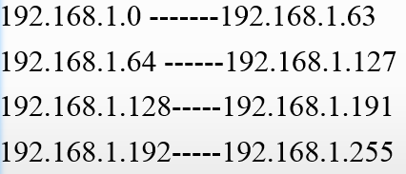
Subnetting
What are the IP range in each subnet?
IP range: 192.168.1.0/24
192.168.1.0
192.168.1.64
192.168.1.128
192.168.1.192
2⁷ | 2⁶ | 2⁵ | 2⁴ | 2³ | 2² | 2¹ | 2⁰
128 | 64 | 32 | 16 | 8 | 4 | 2 | 1
1 | 1 | 0 | 0 | 0 | 0 | 0 | 0
Magic Number=64

Slide 39
Subnetting
What are the third usable IP addresses in each subnet?
Ans:???
What are the Broadcast addresses and network addresses in each subnet?
Ans:??

Slide 40
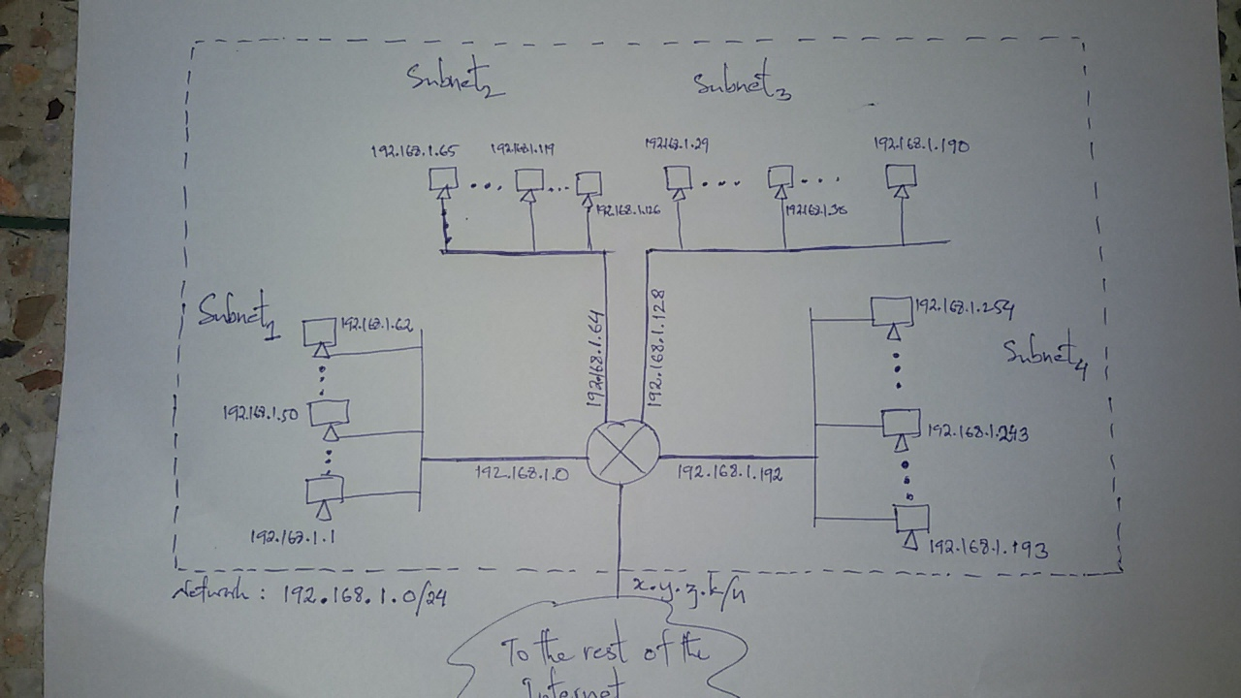
Subnetting
Draw a net diagram to represent the networks.

Slide 41
VLSM
Variable Length Subnet Mask
  It is a technique that allows network administrators to divide an IP address space into subnets of different sizes, unlike simple same-size Subnetting.
    It means subnetting a subnet

Slide 42
VLSM
Variable Length Subnet Mask
  Advantages of VLSM over FLSM
    In Fixed length subnet mask subnetting (FLSM), all subnets are of equal size and have equal number of hosts but in VLSM the size is variable and it can have variable number of hosts thus making the IP addressing more efficient by allowing a routed system of different mask length to suit requirements.
    In FLSM there is a wastage of IP addresses but in VLSM there is a minimum wastage of IP addresses.
    FLSM is preferred for private IP addresses while for public IP addresses VLSM is the best option.

Slide 43
VLSM
Variable Length Subnet Mask
  Disadvantages of VLSM over FLSM
    Complexity: VLSM requires more advanced planning and configuration compared to traditional subnetting, which can increase the complexity of the network design and administration.
    Increased management overhead: With VLSM, there may be more subnets and IP addresses to manage, which can increase the management overhead and make it more difficult to troubleshoot network issues.
    Potential for fragmentation: If subnets are created with different subnet masks, it can lead to IP address fragmentation, where IP addresses are allocated inefficiently and may not be contiguous.
    Compatibility issues: VLSM may not be compatible with older networking equipment or protocols, which can limit its usefulness in certain environments.

Slide 44
VLSM
Variable Length Subnet Mask
4th Octet
3rd Octet
2nd Octet
1st Octet
bit | Host | Subnet Mask
2⁰ | 1 | /32
2¹ | 2 | /31
2² | 4 | /30
2³ | 8 | /29
2⁴ | 16 | /28
2⁵ | 32 | /27
2⁶ | 64 | /26
2⁷ | 128 | /25
bit | Host | Subnet Mask
2⁸ | 256 | /24
2⁹ | 512 | /23
2¹⁰ | 1024 | /22
2¹¹ | 2048 | /21
2¹² | 4096 | /20
2¹³ | 8192 | /19
2¹⁴ | 16384 | /18
2¹⁵ | 32768 | /17
bit | Host | Subnet Mask
2¹⁶ | 65536 | /16
2¹⁷ | 131072 | /15
2¹⁸ | 262144 | /14
2¹⁹ | 524288 | /13
2²⁰ | 1048576 | /12
2²¹ | 2097152 | /11
2²² | 4194304 | /10
2²³ | 8388608 | /9
bit | Host | Subnet Mask
2²⁴ | 16777216 | /8
2²⁵ | 33554432 | /7
2²⁶ | 67108864 | /6
2²⁷ | 134217728 | /5
2²⁸ | 268435456 | /4
2²⁹ | 536870912 | /3
2³⁰ |  | /2
2³¹ |  | /1

Slide 45
VLSM
Variable Length Subnet Mask
  Company NgaNeuron requires three networks: N1 with 100 hosts, N2 with 50 hosts, and N3 with 10 hosts. ISP has provided NgaNeuron with 192.168.10.0/24. Populate the following table.
Host | Subnet mask | octet | Increment | Network Address | Subnet mask | 1st Usable Address | Last Usable Address | Broadcast Address

Slide 46
VLSM
Variable Length Subnet Mask
  Company iTech requires three networks: N1 with 500 hosts, N2 with 200 hosts, and N3 with 100 hosts. ISP has provided iTech with 10.10.0.0/22. Populate the following table.
Host | Subnet mask | octet | Increment | Network Address | Subnet mask | 1st Usable Address | Last Usable Address | Broadcast Address

Slide 47
Subnetting
Q2. An organization is granted the block 17.12.40.0/26. The organization has three offices and needs to divide the addresses into three sub-blocks of 32,16 and 16 addresses.
What are the masks of each subnet?
What is range of addresses in each subnet?
What is the network address and broadcast address in each subnet?
What is the seventh usable address and second last usable address in each subnet?
Draw a net diagram to represent the networks.

Slide 48
Subnetting
What are the masks of each subnet?
Solution:
No. of address= 2^{32-n} (where n is mask)
Subnet1
Therefore, 2^{32-n}=32
2^{32-n}=2⁵
32-n=5
n=32-5
=27
=/27
Subnet2
Therefore, 2^{32-n}=16
2^{32-n}=2⁴
32-n=4
n=32-4
=28
=/28
Subnet3
Therefore, 2^{32-n}=16
2^{32-n}=2⁴
32-n=4
n=32-4
=28
=/28
This means we have the masks /27,/28,/28 with the organization mask being /26

Slide 49
Subnetting
What is range of addresses in each subnet?
Subnet1
17.12.40.0/27 - 17.12.40.31/27
Subnet2
17.12.40.32/28 - 17.12.40.47/28
Subnet3
17.12.40.48/28 - 17.12.40.63/28

Slide 50
Subnetting
What are the network address and broadcast address in each subnet?
What is the seventh usable address and second last usable address in each subnet???
Draw a net diagram to represent the networks. ???
Subnet | Network Address | Broadcast Address
Subnet1 | 17.12.40.0 | 17.12.40.31
Subnet2 | 17.12.40.32 | 17.12.40.47
subnet3 | 17.12.40.48 | 17.12.40.63

Slide 51
Subnetting
Questions:
A network on the Internet has a subnet mask of 255.255.255.224. What is the maximum number of hosts it can handle?
Find the class of the following IP Addresses
  208.34.54.12
  238.34.2.1
  114.34.2.8
  129.14.6.8
  11110111 10101011 11100010 10000100
  10101111 10000000 10101010 10010010
  11011111 10111111 10100011 10111110
  11101111 10111001 00011100 10101010

Slide 52
Subnetting
Questions:
How many total bits are being used to identify the network and how many total bits identify the hosts with the IP address 192.16.5.133/29?
What is the full subnet mask for address 172.16.5.10/28?
Practice Questions https://www.packettracerlab.com/subnetting-practice/

Slide 53
Subnetting
Q: Home Work
An organization is granted the block 130.34.12.64/26. The organization needs to have four subnets with 16 addresses.
What are the masks of each subnet?
What is range of addresses in each subnet?
What is the network address and broadcast address in each subnet?
What is the seventh usable address and second last usable address in each subnet?
Draw a net diagram to represent the networks.

Slide 54
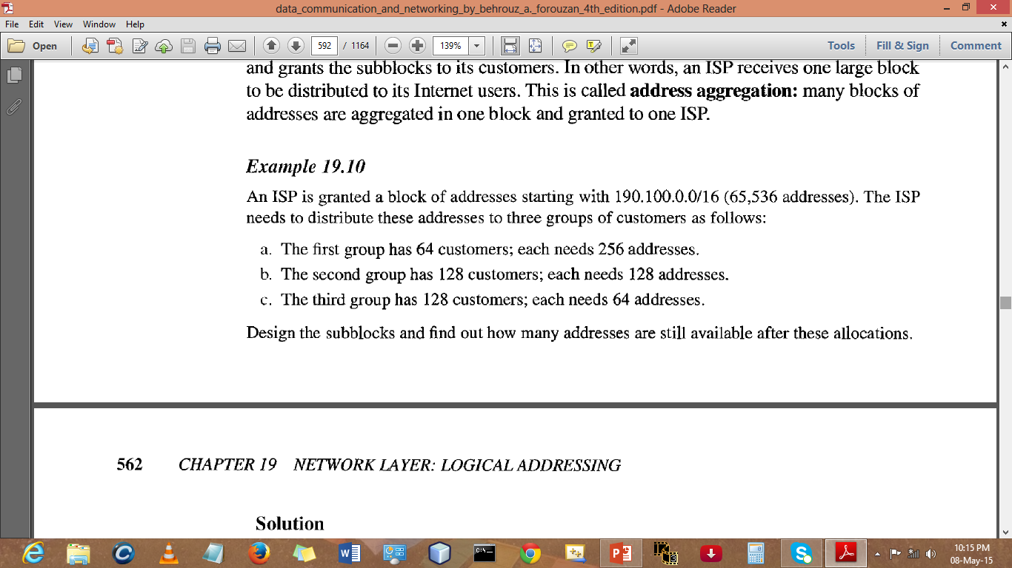
Subnetting

Slide 55
Subnetting
190.100.0.0/16
Solution:
No. of address= 2^{32-n} (where n is mask)
FirstGroup (256 addresse)
Therefore, 2^{32-n}=256
2^{32-n}=2⁸
32-n=8
n=32-8
=24
=/24
SecondGroup(128 addresse)
Therefore, 2^{32-n}=128
2^{32-n}=2⁷
32-n=7
n=32-7
=25
=/25
ThirdGroup(64 addresse)
Therefore, 2^{32-n}=64
2^{32-n}=2⁶
32-n=6
n=32-6
=26
=/26
This means we have the masks /24,/25,/26 with the organization mask being /16

Slide 56
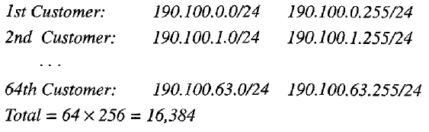
Subnetting
FirstGroup with 64 customers each requiring 256 addresses.
Therefore, address are

Slide 57
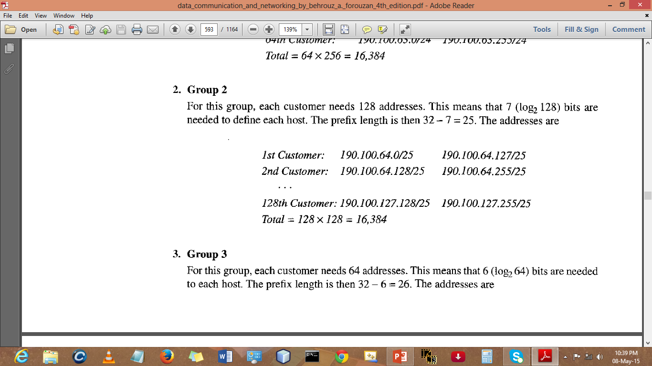
Subnetting
SecondGroup with 128 customers each requiring 128 addresses.
Therefore, address are

Slide 58
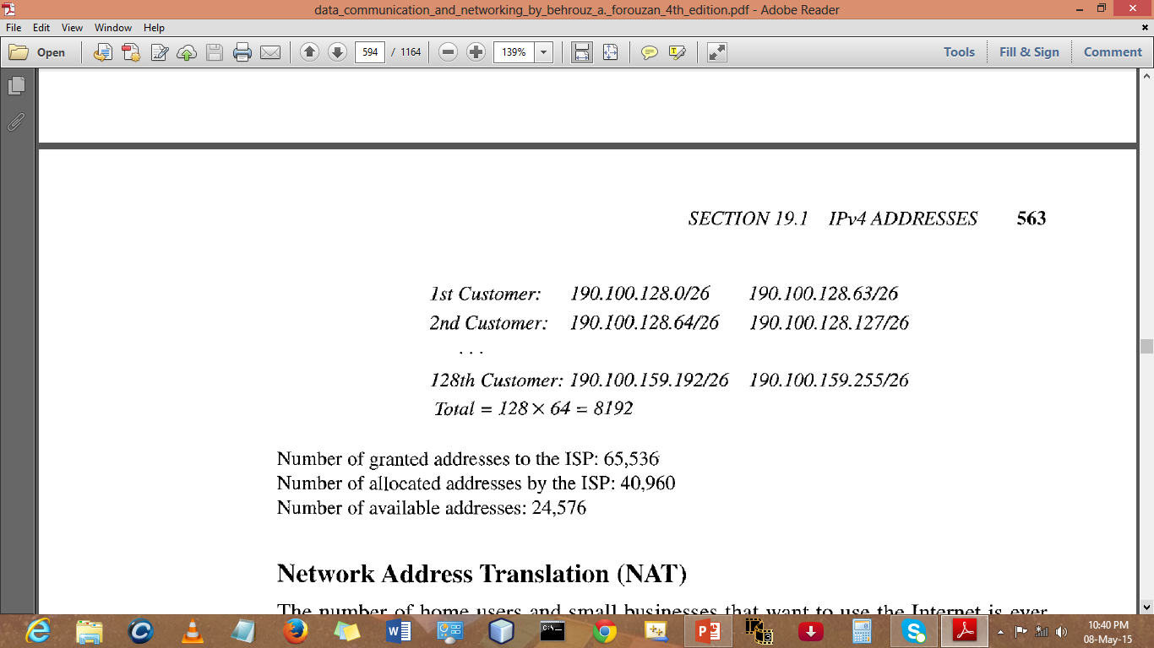
Subnetting
ThirdGroup with 128 customers each requiring 64 addresses.
Therefore, address are

Slide 59
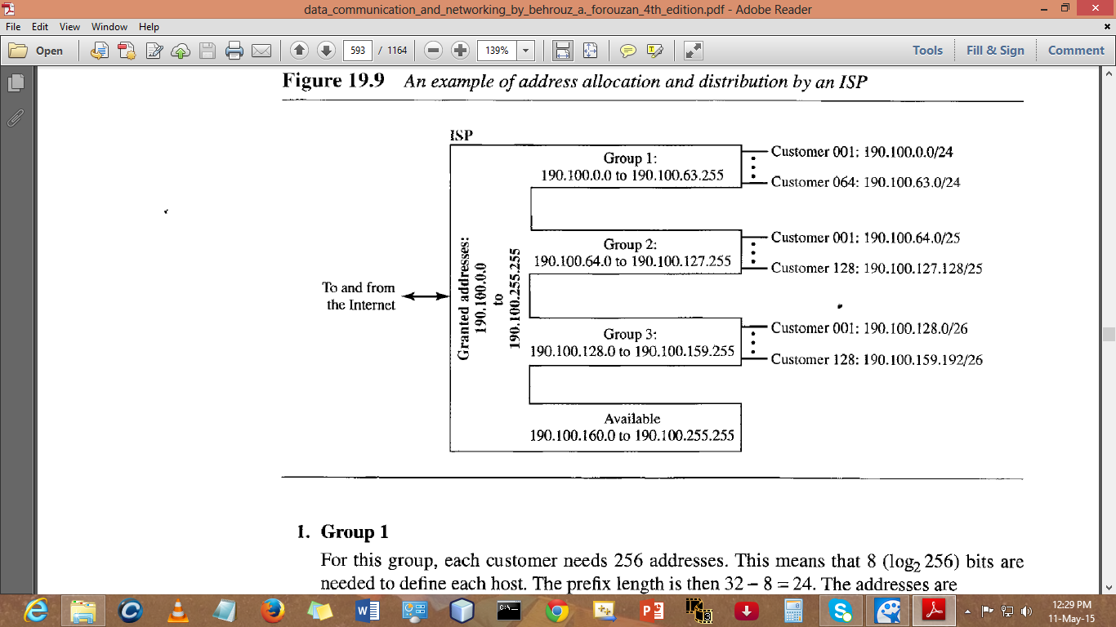
Important Concepts Revision
Sub-block Design

Slide 60
Important Concepts Revision
Address available after allocation is 24576…?
Address Space=2^{32-n}
⁼2³²⁻¹⁶ (190.100.0.0/16)
⁼2¹⁶
⁼⁶⁵⁵³⁶
Address allocated= 64 x 256 =16384
^{=128 x 128=16384}
^{=128 x 64 = 8192}
⁼⁴⁰⁹⁶⁰
Address still available is 65536-40960=24576 address

Slide 61
Supernetting: Supernetting
Supernetting:
As the Internet has grown, IPv4 addresses were depleting.
  Most Class A or B network addresses have already been assigned.
  It has become more difficult for organizations to obtain Class A or Class B addresses for their networks.
  The problem is compounded by the fact that Class C networks are limited to a maximum of 254 hosts.

Slide 62
TCP/IP Protocol Suite: Supernetting
Supernetting:
Subnetting could not completely solve address depletion problems.
  most organization did not want to share their granted blocks with others.
Since class C blocks were still available but the size of the block did not meet the requirement of new organization that wanted to join the Internet.
One solution was supernetting.
  In supernetting, an organization can combine several class C blocks to create a larger range of addresses(a supernetwork)
  With supernetting, you can combine small network into one larger network

Slide 63
TCP/IP Protocol Suite: Supernetting
Supernetting:
A supernet mask is the reverse of a subnet mask.
A subnet mask for class C has more 1s than the default mask for this class.

Slide 64
References
References:
  Stallings, W., Data & Computer Communication, Prentice-Hall
  Tanenbaum, Computers Networks, PHI
  Forouzan, B.A., Data Communication & Networkings, 4th Edition.
  Mr. Yeshi Wangchuk’s CCN Class Slides (2014), College of Science and Technology, Rinchending, Phuentsholing, Bhutan

